Slide 1

Energy calibration at Dalton Cumbria Facility
Energy calibration of a 2.5MV Pelletron at dcf

Slide 2
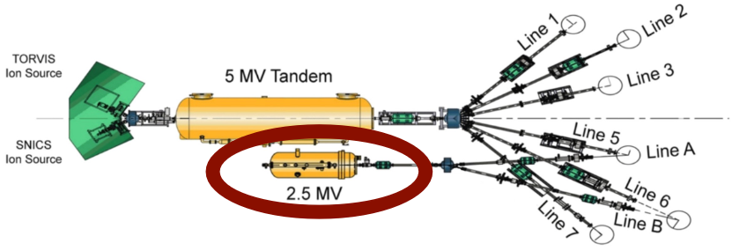
Energy calibration of the 2.5 MV pelletron
Yield measurement of resonance strengths in ²⁷Al(p,γ)²⁸Si due to the well-known strength values
Proton beam onto a ²⁷Al target and a NaI γ -ray detector

Slide 3
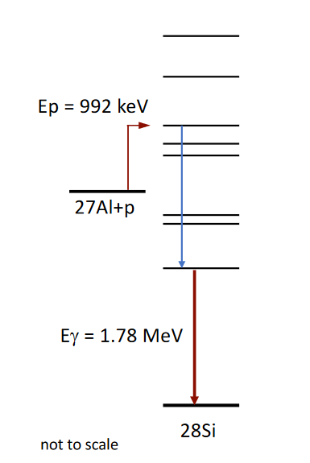
Resonances in ²⁷Al(p, γ)²⁸Si
E_{p} | Γ
632.23 ± 0.04 keV | 6.7 ± 0.5 eV
991.86 ± 0.017 keV | 70 ± 10 eV
1213.08 ± 0.06 keV | < 100 eV
1587.49 ± 0.08 keV | < 200 eV
1799.75 ± 0.09 keV | 450 ± 60 eV

Slide 4
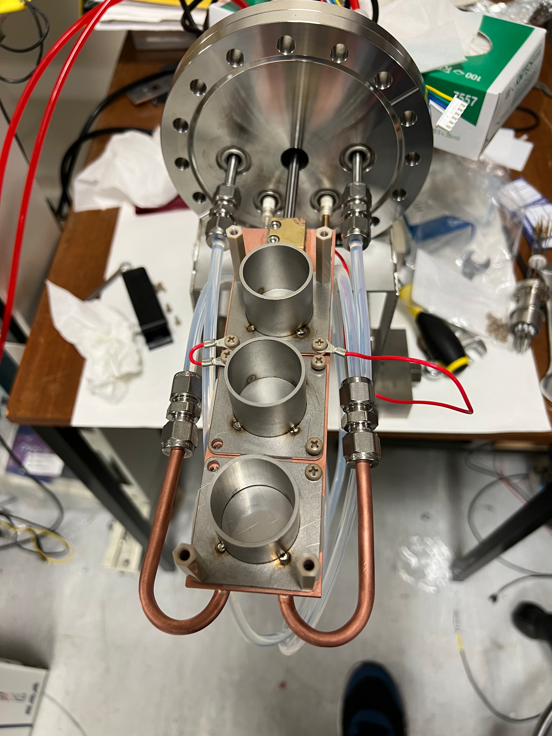
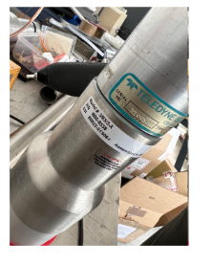
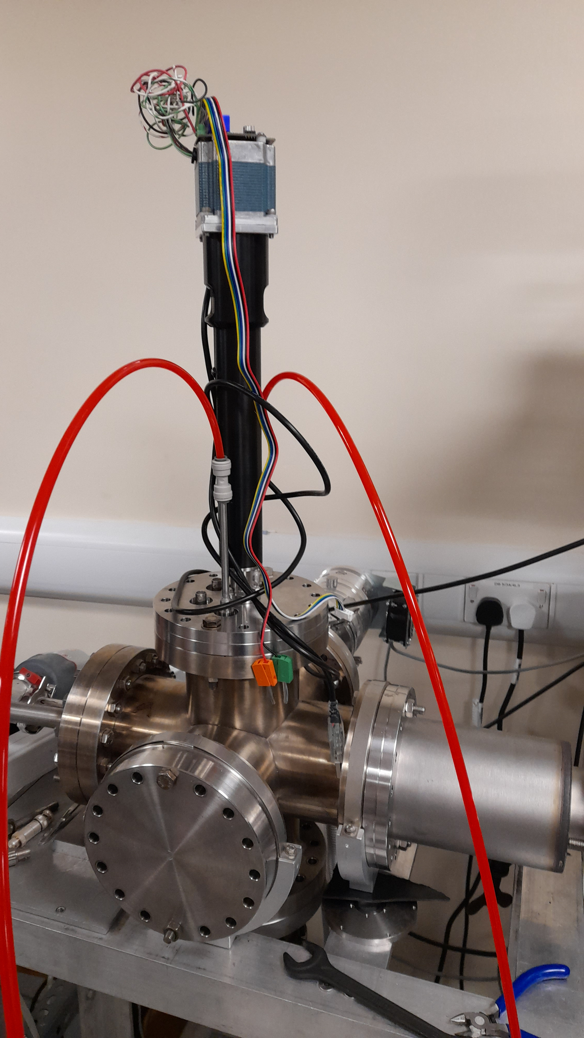
Experimental set up
Aluminium target
Water cooling
Actuator
NaI detector

Slide 5
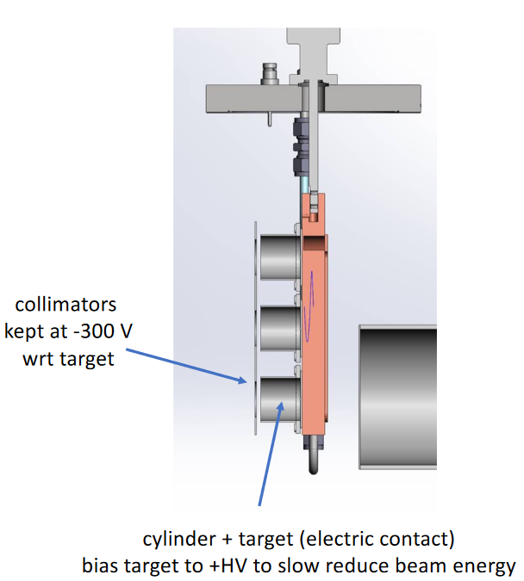
Experimental method
Instead of changing the proton beam parameters a bias voltage was applied to scan through the resonance range.
Initiate the beam with nominal energy
Set up a bias between the target and collimator by 300 V for electron suppression
Beam on target to collect a spectrum with a NaI detector
Save and reset spectrum measurement
Change the target bias voltage to continue the resonance scan

Slide 6
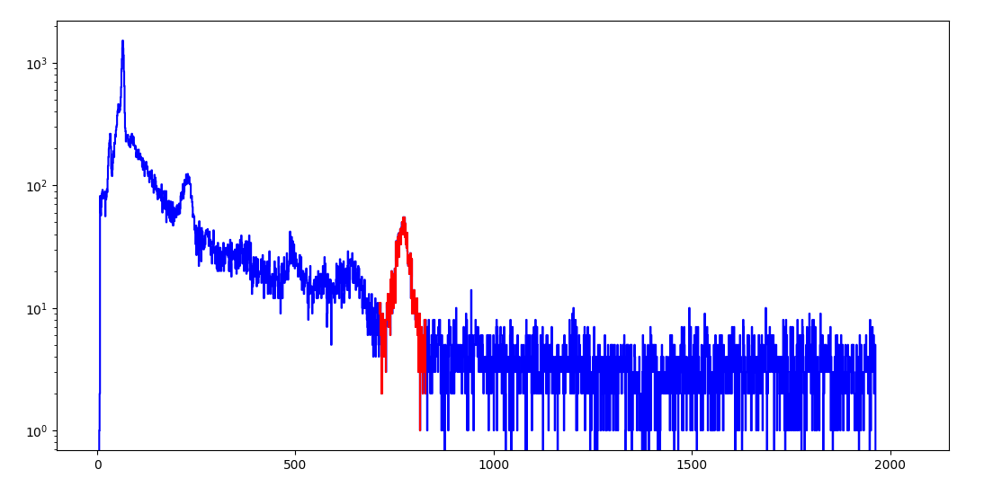
Data fitting
From the ²⁷Al(p, γ)²⁸Si reaction we want to measure gamma emission of about 1.78 MeV so an appropriate region of interest has been selected.
The spectra are saved with the use of Ortec MAESTRO in an ASCII format to allow analysis on raw data.
Count
1.78 MeV
Chanel

Slide 7
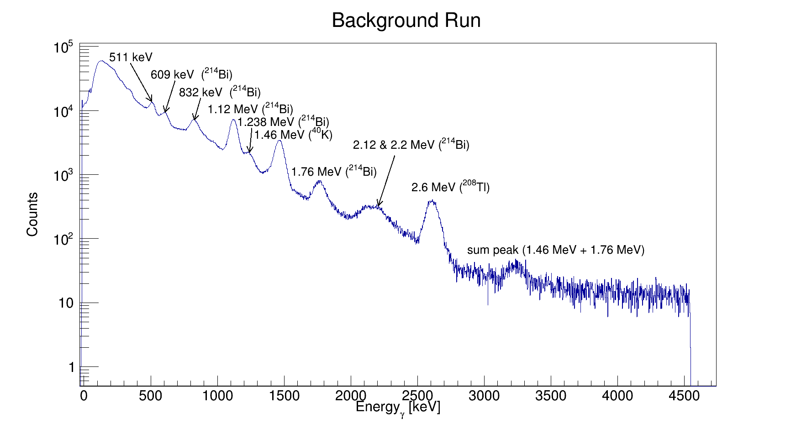
Detector calibration
The NaI detector was calibrated by correlating common background radiation peaks with the gamma energy.
Calibration has been performed at DCF before the first experimental run.

Slide 8
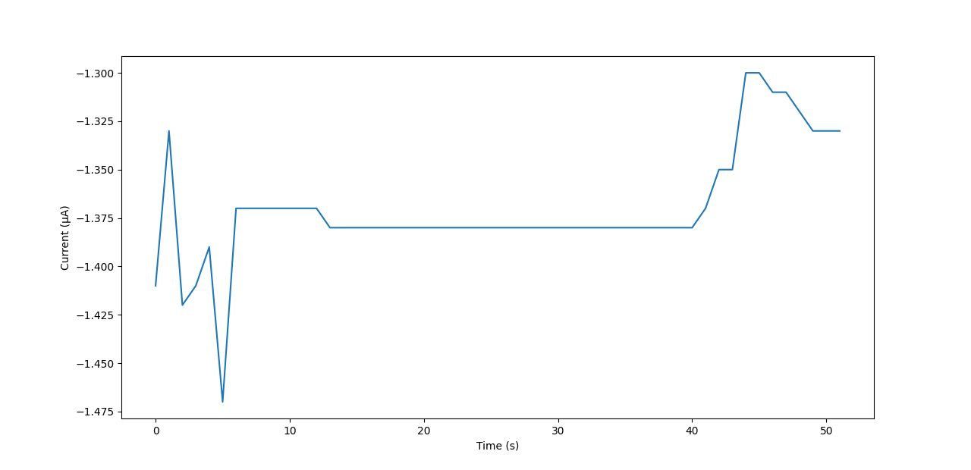
Yield calculation
Due to unstable current output the current values have been integrated.
A Gaussian and a first-degree polynomial is used to find the area under the emission peak.

Slide 9
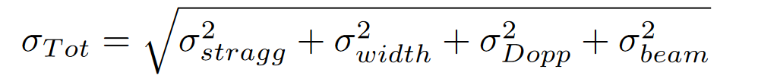
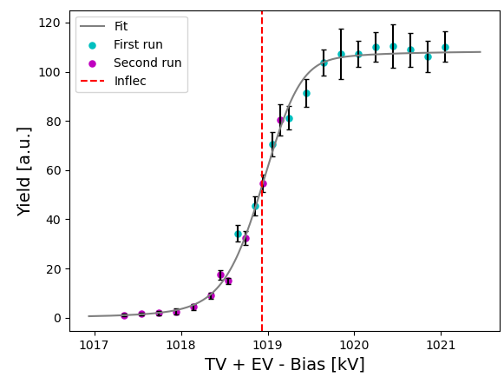
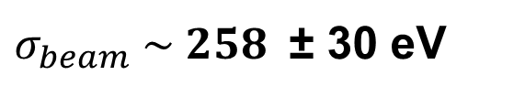
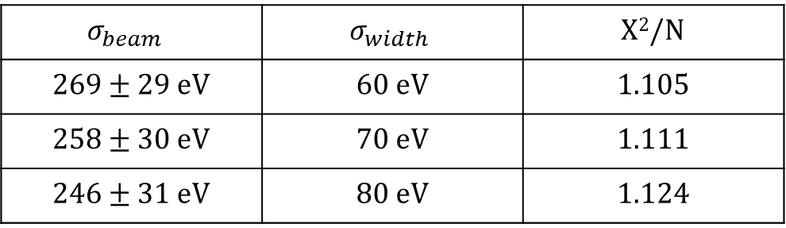
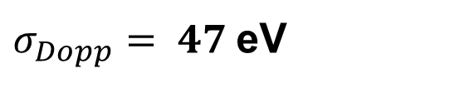
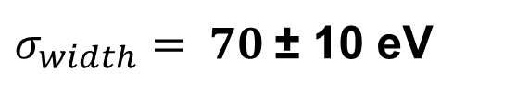
²⁷Al(p, γ) at 991 keV
Fixed
Fixed
Fixed
Free
$σ_{width}= 70 \text{±}\text{ 10 }$eV
$σ_{Dopp}= 47$eV
$σ_{beam} \sim 258$ ± 30 eV
Uncertainty scaled by 2.7 Χ²/N = 1.1
$$σ_{beam}$$ | $$σ_{width}$$ | Χ²/N
269 ± 29 eV | 60 eV | 1.105
258 ± 30 eV | 70 eV | 1.111
246 ± 31 eV | 80 eV | 1.124

Slide 10
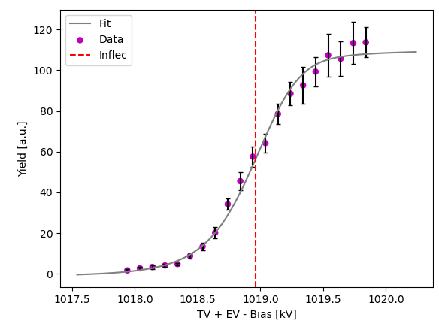
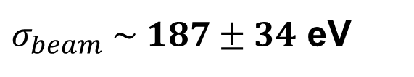
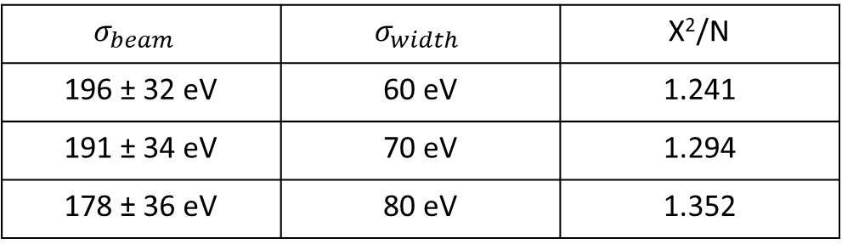
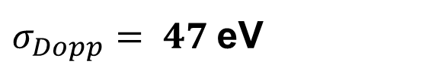
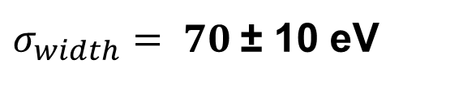
Second measurement at 991 keV
Fixed
Fixed
Fixed
Free
$σ_{width}= 70 \text{±}\text{ 10 }$eV
$σ_{Dopp}= 47$eV
$σ_{beam} \sim 187±34$ eV
Uncertainty scaled by 2.7 Χ²/N = 1.2
$$σ_{beam}$$ | $$σ_{width}$$ | Χ²/N
196 ± 32 eV | 60 eV | 1.241
191 ± 34 eV | 70 eV | 1.294
178 ± 36 eV | 80 eV | 1.352

Slide 11
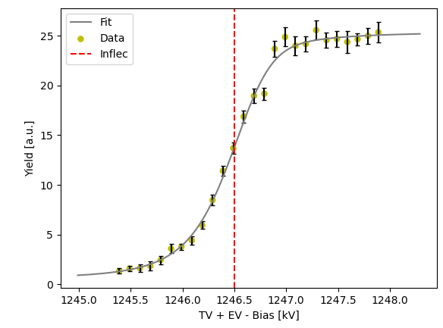
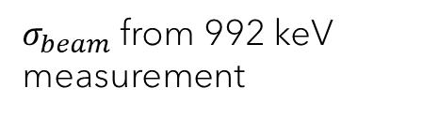
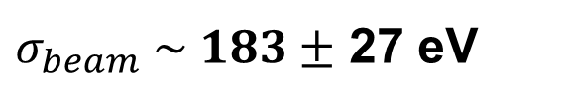
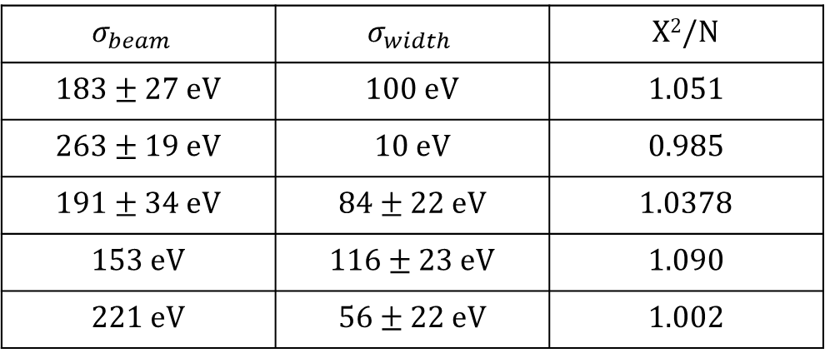
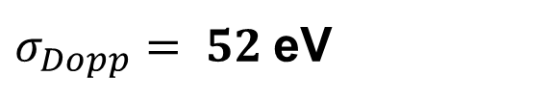
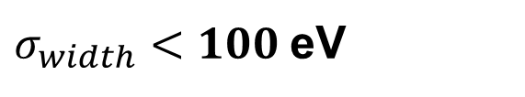
²⁷Al(p, γ) at 1213 keV
Fixed
Fixed
Fixed
Free
$σ_{width}<100$eV
$σ_{Dopp}= 52$eV
$σ_{beam} \sim 183±$ 27 eV
Uncertainty scaled by 1.4 Χ²/N = 1.0
$$σ_{beam}$$ | $$σ_{width}$$ | Χ²/N
183 ± 27 eV | 100 eV | 1.051
263 ± 19 eV | 10 eV | 0.985
191 ± 34 eV | 84 ± 22 eV | 1.0378
153 eV | 116 ± 23 eV | 1.090
221 eV | 56 ± 22 eV | 1.002
$σ_{beam}$ from 992 keV measurement

Slide 12
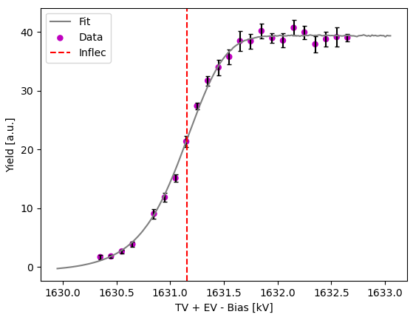
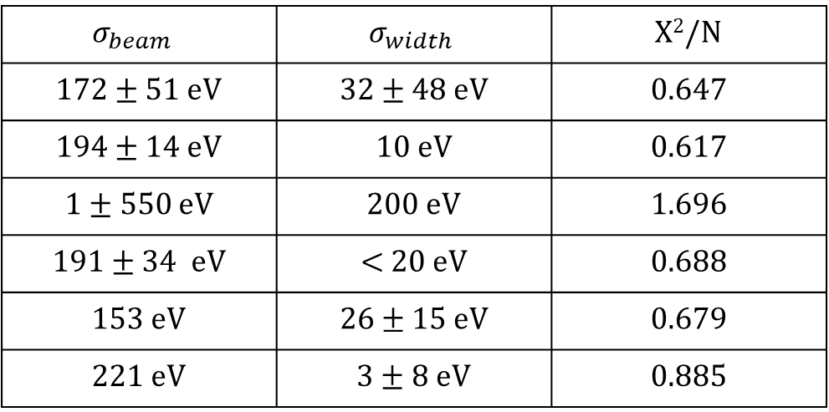
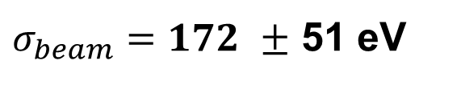
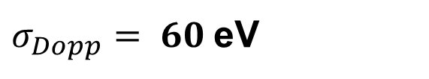
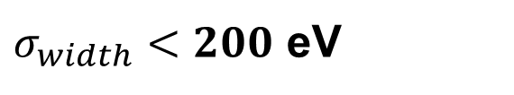
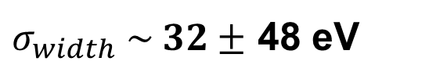
²⁷Al(p, γ) at 1587 keV
Fixed
Free
Fixed
Fixed
Literature value
$σ_{width} \sim 32±$ 48 eV
$σ_{width}<200$ eV
$σ_{Dopp}= 60$eV
$σ_{beam}=172$ $±$ 51 eV
Χ²/N = 1.0
$$σ_{beam}$$ | $$σ_{width}$$ | Χ²/N
172 ± 51 eV | 32 ± 48 eV | 0.647
194 ± 14 eV | 10 eV | 0.617
1 ± 550 eV | 200 eV | 1.696
191 ± 34 eV | < 20 eV | 0.688
153 eV | 26 ± 15 eV | 0.679
221 eV | 3 ± 8 eV | 0.885
$σ_{beam}$ from 992 keV measurement

Slide 13
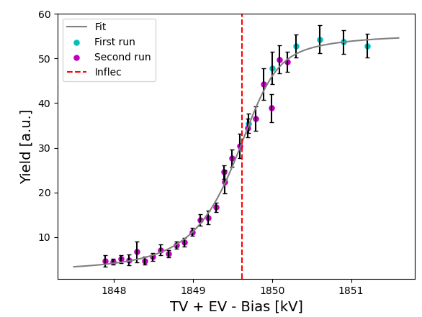
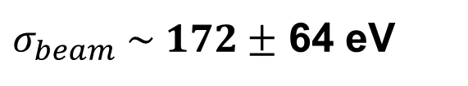
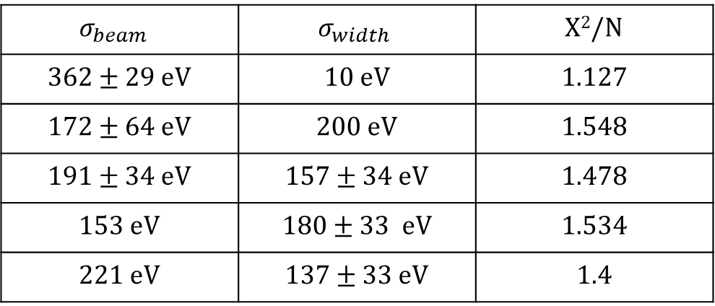
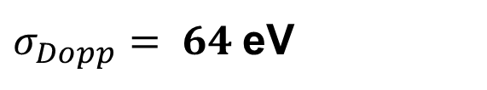
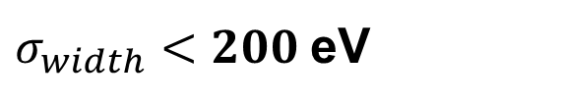
²⁷Al(p, γ) at 1799 keV
Fixed
Fixed
Fixed
Free
$σ_{width}<200$eV
$σ_{Dopp}= 64$eV
$σ_{beam} \sim 172±$ 64 eV
Χ²/N = 1.0
$$σ_{beam}$$ | $$σ_{width}$$ | Χ²/N
362 ± 29 eV | 10 eV | 1.127
172 ± 64 eV | 200 eV | 1.548
191 ± 34 eV | 157 ± 34 eV | 1.478
153 eV | 180 ± 33 eV | 1.534
221 eV | 137 ± 33 eV | 1.4
$σ_{beam}$ from 992 keV measurement

Slide 14
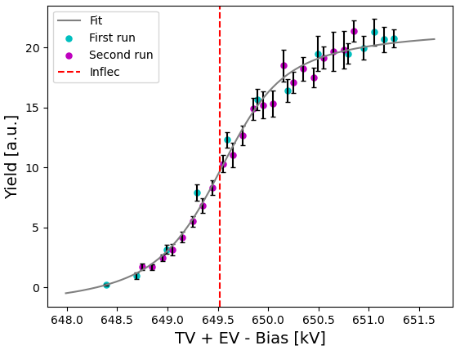
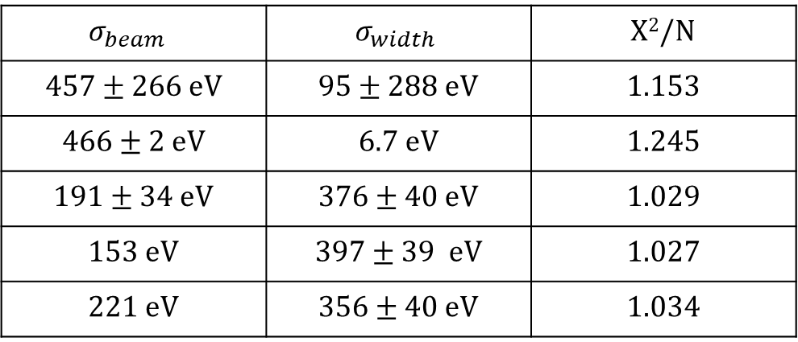
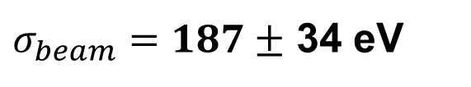
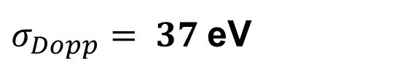
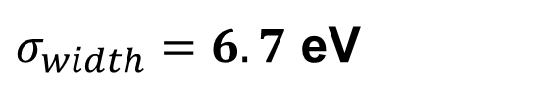

²⁷Al(p, γ) at 632 keV
Fixed
Free
Fixed
Fixed
Literature value
$σ_{width} \sim 379±$ 39 eV
$σ_{width}=6.7$ eV
$σ_{Dopp}= 37$eV
$σ_{beam}=187±$ 34 eV
Uncertainty scaled by 1.4 Χ²/N = 1.2
$$σ_{beam}$$ | $$σ_{width}$$ | Χ²/N
457 ± 266 eV | 95 ± 288 eV | 1.153
466 ± 2 eV | 6.7 eV | 1.245
191 ± 34 eV | 376 ± 40 eV | 1.029
153 eV | 397 ± 39 eV | 1.027
221 eV | 356 ± 40 eV | 1.034
$σ_{beam}$ from 992 keV measurement

Slide 15
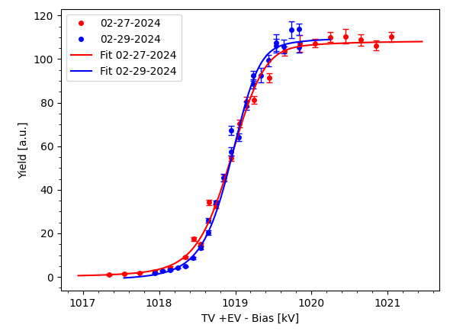
Reproducibility
Two 991 keV measurements have been performed to check for reproducibility.
Both the data and fits are close to each other which suggests good reproducibility

Slide 16
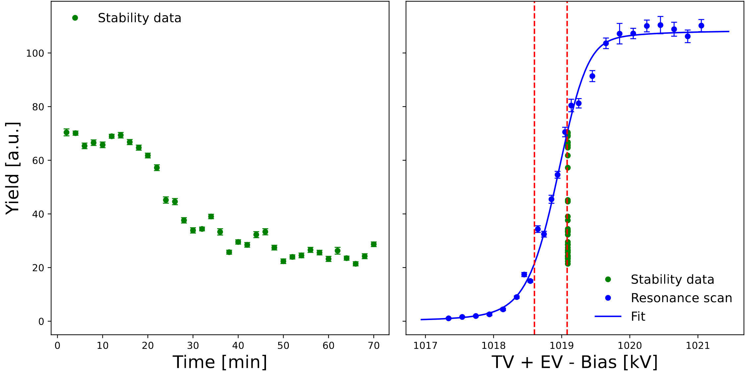
Stability
Voltage drift of 480 V during the measurement

Slide 17
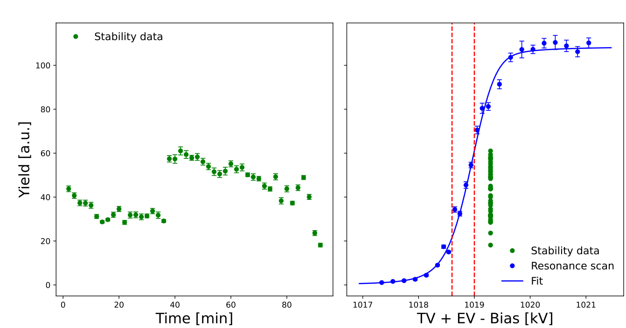
Second stability run
Voltage drift of 400 V during the measurement

Slide 18
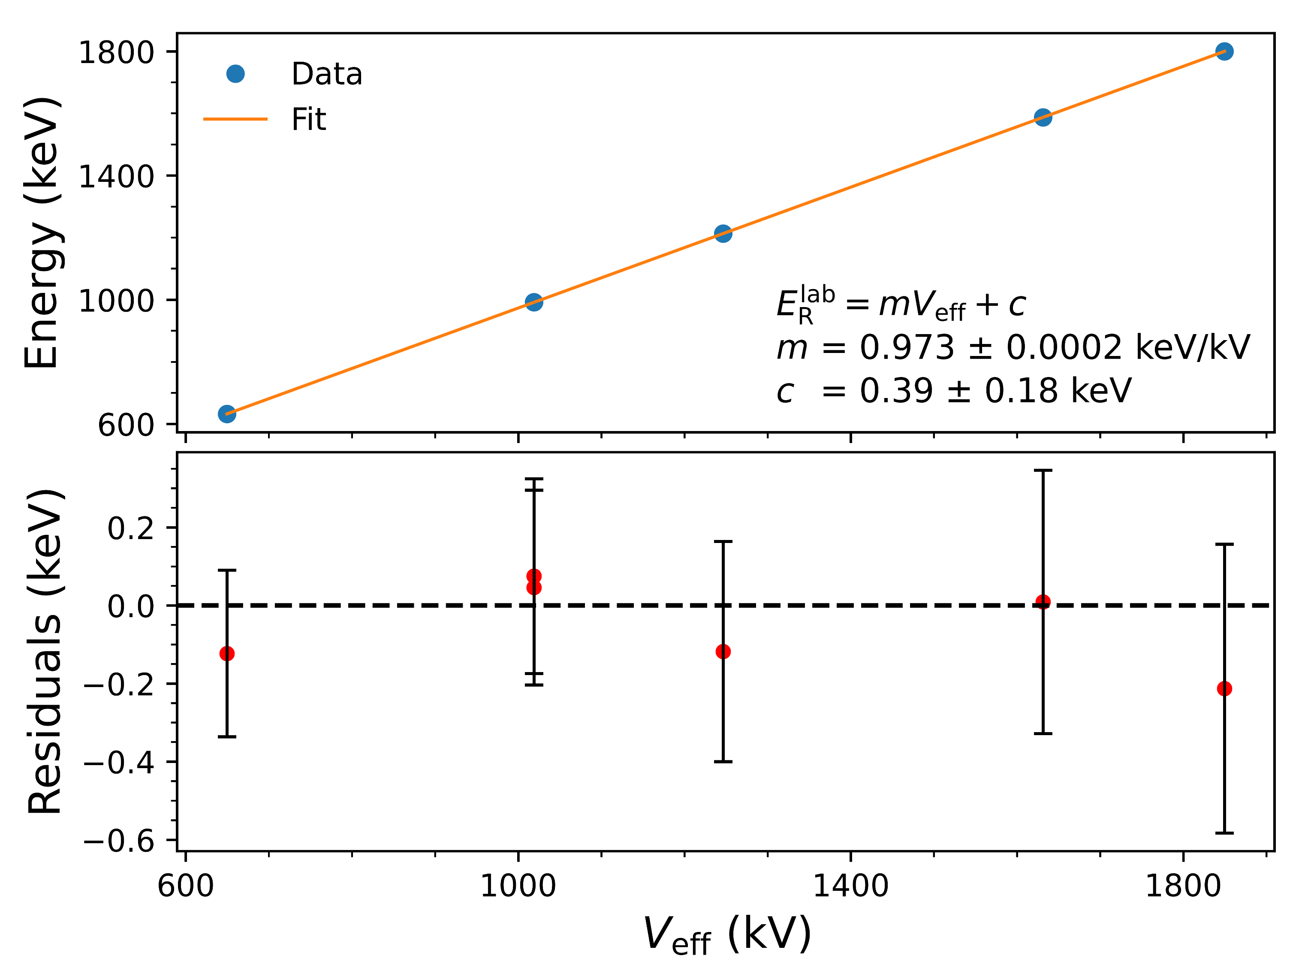
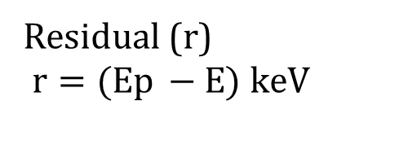
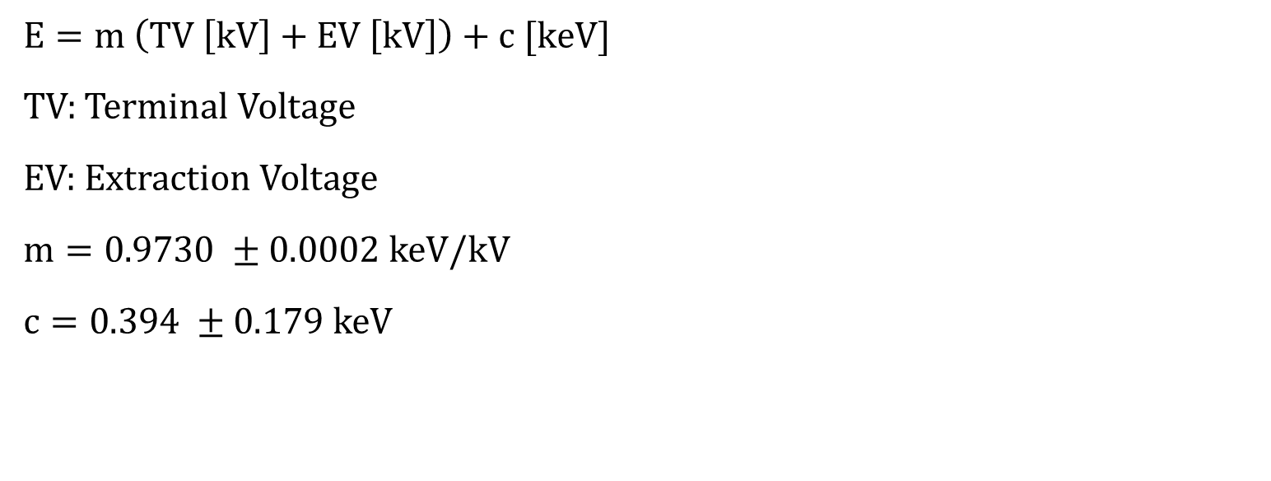
Calibration fit
$$E=m \left(TV \left[kV\right]+EV \left[kV\right]\right)+c [keV]$$
TV: Terminal Voltage
EV: Extraction Voltage
$m=0.9730 ±0.0002$keV/kV
$c=0.394 ±0.179$keV
Residual (r)
$r=(Ep −E) keV$

